Slide 1

WEEK 1 – LECTURE 1 & 2
Mobile Application
Development
Introduction & Development Environment Setup
Beginner-Friendly Course
2026

Slide 2
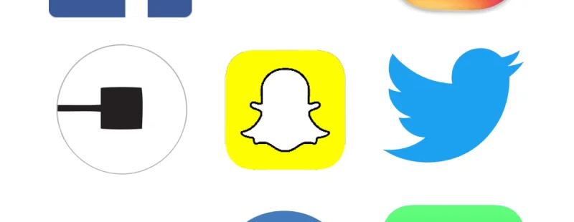
01
Introduction to Mobile Apps
What is a Mobile App?
Key Points
Real-World Example
•
A mobile app is software designed for smartphones and tablets
•
Apps are installed from app stores like Google Play or App Store
•
They use phone features like camera, GPS, and notifications
•
Apps work faster than websites and can work offline
•
They are built by developers using special tools and programming languages
WhatsApp is a mobile app that lets you send messages, make calls, and share photos with friends and family around the world.
Simple Explanation
Think of a mobile app like a special tool on your phone. Just like you have a calculator app or a camera app, other apps like WhatsApp or Instagram are tools that help you do specific things – send messages, share photos, or call a ride.
Visual Suggestion
Diagram: Mobile app ecosystem showing apps, phones, and users
Image: Phone screen showing various app icons

Slide 3
02
Introduction to Mobile Apps
Types of Mobile Applications
Native Apps
Web Apps
Hybrid Apps
•
Built for one specific platform
•
Run in a web browser
•
Mix of native and web
•
Android uses Java/Kotlin
•
Use HTML, CSS, JavaScript
•
Built with web technologies
•
iOS uses Swift
•
No installation needed
•
Work on multiple platforms
•
Best performance and speed
•
Work on any device
•
Faster development
•
Full access to device features
•
Need internet connection
•
Good for simple apps
Simple Explanation
Real-World Example
Native apps are like custom-made shoes – perfect fit but only for one foot. Web apps are like sandals – anyone can wear them. Hybrid apps are like adjustable shoes – fit most people well.
Instagram started as a native app for better camera access. Many banking apps are hybrid – they look like native apps but use web technology inside.
Visual Suggestion
Diagram: Three-column comparison showing Native vs Web vs Hybrid
Image: Instagram app interface showing native features

Slide 4
03
Introduction to Mobile Apps
Apps vs Websites: What's the Difference?
Mobile Apps
Websites
Installed on device from app store
Open in browser (Chrome, Safari)
Work offline (many features)
Need internet connection
Faster performance and smoother
May be slower on mobile
Use device features like camera, GPS
Limited device access
Send push notifications
Always up-to-date automatically
Simple Explanation
Real-World Example
Think of it this way: a mobile app is like a program installed on your computer – it's always there and works fast. A website is like visiting a library – you need to go there (open browser) and need internet to access it.
Mobile banking app vs bank website: The app lets you deposit checks using camera, get instant notifications, and works offline for viewing balance. The website needs you to log in every time and can't use your camera.

Slide 5
04
Introduction to Mobile Apps
How Do Mobile Apps Work?
Simple Workflow
1. You Tap
2. App Processes
3. Shows Result
User touches a button or icon on screen
App understands what you want and works on it
App displays information or completes action
Key Points
Real-World Example
•
Apps have screens (like pages in a book)
•
Each screen has buttons, text, images
Uber
•
Tapping buttons triggers actions
Ride-hailing app
•
Apps can connect to internet for data
1. You tap: "Where to?" box
•
Some apps work without internet
2. App processes: Finds your location, searches for nearby drivers
3. Shows result: Driver name, car type, arrival time, price
Simple Explanation
Visual Suggestion
Think of an app like a restaurant. You (user) look at the menu (screen), tell the waiter what you want (tap button), the kitchen prepares it (app processes), and brings you food (shows result).
Diagram: App workflow from user action to result
Image: Uber app screens showing the process

Slide 6
05
Introduction to Mobile Apps
Common Features of Mobile Apps
Touch Interface
Notifications
Camera Access
GPS Location
Offline Storage
Tap, swipe, pinch to interact
Alerts and messages
Take photos and videos
Maps and navigation
Save data on device
Key Points
Real-World Example
•
Apps use touch gestures for navigation
•
Push notifications keep users engaged
DoorDash
•
Camera enables photo/video features
Food delivery app
•
GPS provides location-based services
Touch: Browse restaurants, tap to order
•
Storage allows offline access to content
GPS: Shows nearby restaurants, tracks delivery
Notifications: Alerts when food is ready
Camera: Take photo of delivery issues
Storage: Saves order history and preferences
Simple Explanation
Mobile apps are like super-powered tools that use your phone's special abilities. Just like a Swiss Army knife has many tools, apps use your phone's camera, GPS, and sensors to do amazing things.
Visual Suggestion
Diagram: Phone with feature icons around it
Image: DoorDash app showing GPS tracking

Slide 7
06
Course Overview
What You Will Learn
01
Understanding Mobile Platforms
02
Setting Up Development Tools
•
Learn about Android, iOS, and Cross-Platform
•
Install and configure Android Studio
•
Understand differences and strengths of each
•
Set up Xcode on Mac (if applicable)
•
Know which platform to choose for your project
•
Configure VS Code for mobile development
03
Learning Frameworks
04
Building Your First App
•
Introduction to Flutter framework
•
Create a simple working app
•
Introduction to React Native framework
•
Learn basic coding concepts
•
Understand when to use each
•
Understand app structure
Simple Explanation
Learning Journey
This course is your roadmap from complete beginner to app builder. Just like learning to drive starts with understanding the car, we'll start with the basics and gradually build your skills.
Beginner
Tools Setup
App Builder

Slide 8
07
Course Overview
Course Objectives and Outcomes
Learning Objectives
Expected Outcomes
Understand App Development Basics
1
Platform Knowledge
Learn what mobile apps are and how they work
You can explain the differences between Android, iOS, and Cross-Platform development
Know Different Platforms
Understand Android, iOS, and Cross-Platform
2
Tool Proficiency
You have Android Studio, Xcode, or VS Code installed and ready to use
Set Up Development Environment
Install and configure required tools
3
Framework Awareness
You understand when to use Flutter vs React Native for projects
Understand Flutter & React Native
Learn about popular frameworks
Simple Explanation
Be Ready to Build Apps
Think of this course as learning to cook. First, you learn about ingredients (platforms), then you set up your kitchen (development tools), and finally you learn recipes (frameworks) to create delicious meals (apps).
Have skills to start creating apps

Slide 9
08
Course Overview
Skills You Will Develop
Using IDEs
Code Structure
Debugging Basics
Master development environments
Understand how code is organized
Find and fix errors in code
• Android Studio
• Files and folders
• Reading error messages
• Xcode
• Functions and classes
• Using debug tools
• VS Code
• Import statements
• Testing solutions
UI Design
App Testing
Simple Explanation
These skills are like tools in a toolbox. Just as a carpenter needs a hammer, saw, and measuring tape, a developer needs IDEs, coding knowledge, and debugging skills to build great apps.
Create user-friendly interfaces with buttons, text, and layouts
Test apps on emulators and real devices to ensure quality
Your Developer Toolbox
IDEs
Code
Debug
Design
Test

Slide 10
09
Course Overview
Real-World Applications of This Course
Mobile App Developer
UI/UX Designer
Full-time career path
Design-focused role
•
Work at tech companies or startups
•
Create beautiful app interfaces
•
Build apps for millions of users
•
Focus on user experience
•
Salary range: $60K - $150K+ per year
•
Work with developers to implement designs
Freelance Developer
Startup Founder
Be your own boss
Build your own app
•
Work on multiple projects
•
Turn your app idea into reality
•
Set your own schedule
•
Create apps that solve problems
•
Earn $50 - $200+ per hour
•
No coding partner needed to start
Simple Explanation
Learning mobile app development opens multiple career doors. Whether you want a stable job at a big company, creative freedom as a freelancer, or to build your own startup, these skills are your foundation.

Slide 11
10
Importance of Mobile Development
Why Mobile Apps Matter Today
By The Numbers
Key Points
Everyone has a smartphone – your potential audience is huge
6.8B
4.5h
People spend 4+ hours daily on mobile apps
Smartphone Users
Daily Screen Time
Worldwide in 2026
Average per person
Mobile commerce is growing rapidly
Businesses need apps to stay competitive
250+
$500B
High demand for skilled developers
Apps Installed
App Revenue
Average per phone
Global market size
Simple Explanation
Visual Suggestion
Mobile apps are no longer just nice-to-have – they're essential. With almost 7 billion people using smartphones, apps have become the primary way we communicate, shop, work, and entertain ourselves.
Diagram: Global mobile usage statistics infographic
Image: People using smartphones in different situations

Slide 12
11
Importance of Mobile Development
Mobile Apps in Daily Life
Communication
Shopping
Transport
Entertainment
Banking
WhatsApp, Messenger
Amazon, eBay
Uber, Lyft
Netflix, Spotify
Mobile banking
Key Points
A Day with Mobile Apps
•
Apps are integrated into every part of our day
Morning
•
From morning alarm to nighttime reading
Alarm app → Weather app → News app
•
They make tasks faster and easier
Work
Email app → Calendar → Video calls
•
We depend on them for work and leisure
Lunch
•
They connect us with people worldwide
Food delivery app → Payment app
Evening
Social media → Streaming → Sleep tracker
Simple Explanation
Imagine your day without any apps. No alarm, no WhatsApp messages, no Uber, no music. Apps have become as essential as electricity and water in our modern lives.
Visual Suggestion
Diagram: Timeline showing app usage throughout the day
Image: Collage of popular app icons

Slide 13
12
Importance of Mobile Development
Business Opportunities in Mobile Development
Customer Reach
Revenue Streams
•
Apps put your business in customers' pockets
•
In-app purchases (buy within app)
•
24/7 accessibility to products/services
•
Subscription models (monthly fees)
•
Direct communication channel with users
•
Advertising revenue (show ads)
App-Based Business
Mobile-First Strategy
•
Uber – taxi service without owning cars
•
Design for mobile first, desktop second
•
Airbnb – hotel service without owning rooms
•
Better user experience on mobile
•
DoorDash – food delivery without restaurants
•
Stay ahead of competitors
Simple Explanation
A mobile app is like having a store that never closes and is accessible to billions of people. Whether you're a small coffee shop or a global brand, an app can dramatically increase your reach and revenue.

Slide 14
13
Importance of Mobile Development
Career Opportunities in Mobile App Development
Career Paths
Job Market Stats
Android Developer
$70K - $140K
25%
500K+
Build apps for Android devices using Java or Kotlin
Job Growth
Open Positions
Next 5 years
Worldwide
iOS Developer
$80K - $150K
Create apps for iPhone and iPad using Swift
$100K
Remote
Average Salary
Work Options
Cross-Platform Developer
$75K - $145K
In the US
80% of jobs
Build apps for both platforms using Flutter or React Native
Simple Explanation
Visual Suggestion
Mobile development offers some of the highest-paying jobs in tech. Companies are desperate for skilled developers, and you can work from anywhere in the world.
Diagram: Career path flowchart with salary ranges
Image: Job listings showing mobile developer positions

Slide 15
14
Importance of Mobile Development
The Future of Mobile Apps
AI-Powered Apps
Augmented Reality
Internet of Things
•
Smart assistants like Siri and Alexa
•
Pokemon GO style games
•
Smart home control apps
•
Personalized recommendations
•
Virtual try-on for shopping
•
Wearable device integration
•
Automated tasks and responses
•
Interactive learning experiences
•
Connected cars and health devices
Key Points
Real-World Example
•
5G technology enables faster, richer apps
•
Wearable apps for watches and glasses
Pokemon GO
•
Voice-controlled interfaces
AR Gaming Revolution
•
Blockchain integration for security
Pokemon GO used augmented reality to overlay Pokemon characters onto the real world through your phone camera. Players walked around their neighborhoods catching virtual creatures.
•
Foldable device support
Result: 1 billion+ downloads, $6 billion revenue
Simple Explanation
The future of mobile apps is like science fiction becoming reality. Your phone will become a magic wand that controls your home, shows you virtual worlds, and understands your needs before you do.
Visual Suggestion
Diagram: Future tech trends timeline
Image: Pokemon GO AR gameplay screenshot

Slide 16
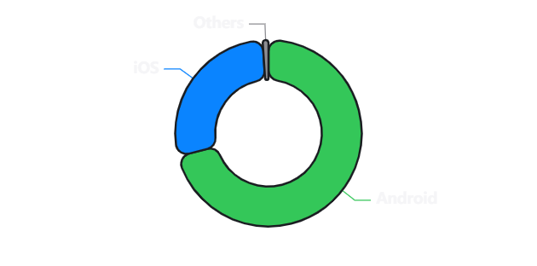
15
Mobile Platforms
Overview of Mobile Platforms
Android
iOS
Cross-Platform
Google's open-source platform
Apple's closed ecosystem
One code, multiple platforms
71%
28%
~1%
Global market share
Global market share
Other platforms
Key Points
Market Share Visualization
•
Android dominates globally with 71% share
•
iOS is strong in US, Europe, and premium markets
•
Cross-platform saves time and money
•
Each platform has different strengths
•
Choice depends on target audience
Simple Explanation
Visual Suggestion
Think of mobile platforms like different car brands. Android is like Toyota – popular worldwide. iOS is like BMW – premium and exclusive. Cross-platform is like a car that can drive on any road.
Diagram: Platform comparison with market share
Image: Android and iOS devices side by side

Slide 17
16
Mobile Platforms
Android Platform: Open Ecosystem
What is Android?
Android Strengths
Developed by Google in 2008
Affordable Devices
Open-source – anyone can use and modify
Phones range from $50 to $2000, making it accessible to everyone
Used by many manufacturers: Samsung, Xiaomi, OnePlus
Largest global market share (71%)
Customization
Apps distributed via Google Play Store
Users can change almost everything – home screen, default apps, etc.
Huge User Base
More potential customers for your apps worldwide
Simple Explanation
Android is like a public park – everyone can visit, play, and even help maintain it. Because it's open-source, many companies use it to create their own versions.
Visual Suggestion
Diagram: Android ecosystem showing manufacturers
Image: Various Android phones from different brands

Slide 18
17
Mobile Platforms
iOS Platform: Apple Ecosystem
What is iOS?
iOS Strengths
Developed by Apple in 2007
Better Security
Closed ecosystem – only Apple can use it
Strict app review process keeps malware out. Users trust iOS apps more.
Runs only on Apple devices: iPhone, iPad
Known for security and quality
Higher Revenue
Apps distributed via App Store
iOS users spend 2.5x more on apps than Android users
User Experience
Consistent design and smooth performance across all devices
Simple Explanation
iOS is like an exclusive club – only Apple members can enter. This control means everything works smoothly together, but you have less freedom to customize.
Visual Suggestion
Diagram: Apple ecosystem showing device integration
Image: iPhone and iPad showing iOS interface

Slide 19
18
Mobile Platforms
Cross-Platform: One Code, Multiple Apps
How It Works
Write Code Once
Framework Converts
Runs Everywhere
Use one programming language
Transforms to native code
Android + iOS apps
Key Points
Cost & Time Comparison
•
Save time – write once, deploy twice
•
Save money – one team instead of two
Native Development
2x cost & time
•
Consistent experience across platforms
Cross-Platform
1x cost & time
•
Faster updates – change once, update all
•
Popular frameworks: Flutter, React Native
Save up to 50% in development costs!
Simple Explanation
Visual Suggestion
Cross-platform development is like speaking a universal language. Instead of learning English and French separately, you learn one language that both groups understand.
Diagram: Code conversion process visualization
Image: Same app running on Android and iPhone

Slide 20
19
Mobile Platforms
Choosing the Right Platform
Decision Factors
Target Audience
Budget
Timeline
Complexity
Who are your users?
How much can you spend?
How soon do you need it?
How complex is your app?
Decision Guide
Decision Flowchart
Choose Android if: You want maximum reach, have budget constraints, or target emerging markets
Start: What's your budget?
Choose iOS if: You target premium users, need high security, or want higher revenue per user
Low
High
Choose Cross-Platform if: You have limited budget, need fast launch, or want both platforms
Cross-Platform
Native (Both)
Simple Explanation
Choosing a platform is like choosing a restaurant. Android is a food court (many options, affordable), iOS is a fine dining restaurant (premium experience), and cross-platform is a buffet (get everything at once).
Visual Suggestion
Diagram: Detailed decision tree flowchart
Image: Infographic comparing platform choices

Slide 21
20
Development Environment Setup
What is a Development Environment?
Simple Definition
Components
A development environment is your digital workspace
Code Editor
It's like a workshop with all tools you need
Where you write and edit your code. Like a text editor but smarter.
Includes code editor, compiler, debugger
Has device simulators for testing
Compiler
Everything is installed on your computer
Translates your code into language the computer understands.
Debugger
Helps you find and fix errors in your code.
Simple Explanation
Think of a development environment like a chef's kitchen. Just as a chef needs a stove, knives, and ingredients, a developer needs an IDE, compilers, and testing tools to build apps.
Visual Suggestion
Diagram: Development environment components
Image: Workspace setup with multiple monitors

Slide 22
21
Development Environment Setup
What is an IDE?
IDE = Integrated Development Environment
Code Editor
Debugger
Build Tools
Emulator
Extensions
Write code
Fix errors
Compile app
Test app
Add features
Key Points
Why You Need an IDE
•
IDE combines all tools in one place
•
Syntax highlighting makes code readable
Faster Development
•
Auto-completion speeds up coding
Auto-complete and templates save hours of typing
•
Error detection catches mistakes early
Easy Debugging
•
Project management organizes files
Find and fix errors with visual tools and breakpoints
Better Code Quality
Built-in checks ensure your code follows best practices
Simple Explanation
Visual Suggestion
An IDE is like a Swiss Army knife for developers. Instead of carrying separate tools, you have everything in one convenient package – editor, debugger, and tester.
Diagram: IDE components and workflow
Image: Split-screen showing code and emulator

Slide 23
22
IDE Installation
Installing Android Studio: Step-by-Step
Installation Steps
Common Issues
1
Check Requirements
Issue: "Not enough disk space"
Windows 10/11, Mac, or Linux. 8GB RAM minimum.
Fix: Free up 4GB+ space or install on external drive
Issue: "JDK not found"
2
Download
Fix: Android Studio includes JDK – just click "Next"
Go to developer.android.com/studio and download
Issue: Slow performance
Run Installer
Fix: Close other apps, increase RAM allocation
3
Double-click the downloaded file and follow wizard
First Launch
Simple Explanation
4
Open Android Studio and complete setup wizard
Installing Android Studio is like setting up a new kitchen. Download the appliance (installer), plug it in (run installer), and organize your tools (first launch setup).
Lab Steps
🔍
⬇️
⚙️
🚀
Step 1
Step 2
Step 3
Step 4
Check system requirements
Download from official site
Run installation wizard
Launch and verify

Slide 24
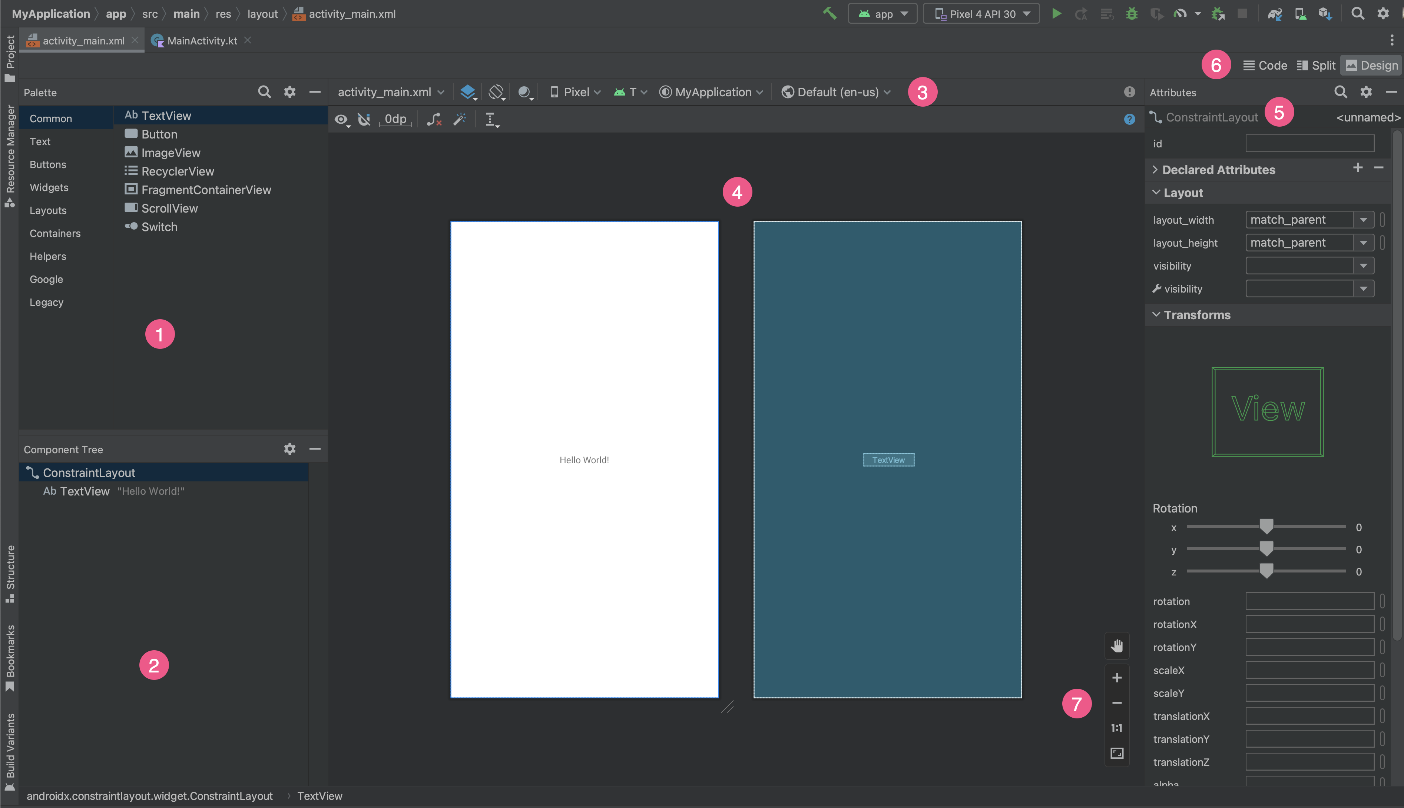
23
IDE Installation
Android Studio: What You Should See
Main Interface Areas
Interface Screenshot
Welcome Screen
First thing you see – options to create new project, open existing, or check out from version control
Project Structure
Left panel showing all your files and folders – like a file explorer for your app
Code Editor
Center area where you write code – has syntax highlighting and auto-completion
Key Features to Notice
Simple Explanation
Run button (green triangle)
Debug button
Android Studio's interface is like a pilot's cockpit. Each panel has a specific purpose – navigation (project structure), controls (code editor), and displays (emulator).
Search icon
Device manager

Slide 25
24
IDE Installation
Installing Xcode: Step-by-Step (Mac Only)
Important: Mac Only!
Xcode only works on macOS. Windows users can skip this and use Android Studio or VS Code instead.
Installation Steps
Common Issues
1
Check macOS Version
Issue: "Not enough space"
Requires macOS 12.0 or later
Fix: Need 40GB+ free space
2
Open App Store
Search for "Xcode" and click "Get"
Issue: Download very slow
Wait for Download
Fix: Use stable Wi-Fi, download overnight
3
Large file (10GB+), may take 30-60 minutes
Issue: "macOS version too old"
4
First Launch
Fix: Update macOS first
Open Xcode and install additional components
Simple Explanation
Visual Suggestion
Installing Xcode is like downloading a large game from the App Store. It takes time because it includes everything you need to build iOS apps – simulators, tools, and documentation.
Diagram: Xcode installation flowchart
Image: Mac App Store showing Xcode download
Lab Steps
🍎
🛒
⏳
🚀
Step 1
Step 2
Step 3
Step 4
Verify macOS version
Download from App Store
Wait for installation
Launch and verify

Slide 26
25
IDE Installation
Installing VS Code: Step-by-Step
Installation Steps
Why VS Code?
1
Download VS Code
Lightweight
Go to code.visualstudio.com and download for your OS
Uses less RAM than Android Studio or Xcode
Extensible
2
Run Installer
Thousands of extensions for any programming need
Double-click downloaded file and follow instructions
Cross-Platform
3
Install Extensions
Works on Windows, Mac, and Linux
Add Flutter, Dart, or React Native extensions
4
Configure Settings
Simple Explanation
Set up themes, fonts, and shortcuts to your preference
VS Code is like a lightweight Swiss Army knife. It's fast, works everywhere, and you can add tools (extensions) as needed. Perfect for beginners!
Lab Steps
⬇️
⚙️
🧩
🚀
Step 1
Step 2
Step 3
Step 4
Download from official site
Run installer
Install mobile dev extensions
Launch and explore

Slide 27
26
Framework Introduction
Introduction to Flutter
What is Flutter?
Key Features
Google's UI toolkit for building apps
Hot Reload
Uses Dart programming language
See changes instantly without restarting the app. Saves hours of development time!
Builds beautiful native apps
Single codebase for Android and iOS
Beautiful UI
Fast development with Hot Reload
Pre-built widgets for Material Design and Cupertino (iOS) styles
High Performance
Compiles to native code – apps run at 60fps smoothly
Simple Explanation
Visual Suggestion
Flutter is like a universal translator. You write your app in one language (Dart), and Flutter translates it to work perfectly on both Android and iOS phones.
Diagram: Flutter architecture showing layers
Image: Flutter logo and sample app interfaces

Slide 28
27
Framework Introduction
Introduction to React Native
What is React Native?
Key Features
Facebook's framework (now Meta)
Learn Once, Write Anywhere
Uses JavaScript – very popular language
Use your web development skills to build mobile apps
Builds truly native apps
Uses web technologies (HTML-like)
Live Reload
Huge community support
See changes immediately as you code
Rich Ecosystem
Thousands of libraries and plugins available
Simple Explanation
React Native is like learning one language to talk to everyone. Since JavaScript is the most popular programming language, millions of developers can easily build mobile apps with it.
Visual Suggestion
Diagram: React Native architecture
Image: React Native logo and Facebook app

Slide 29
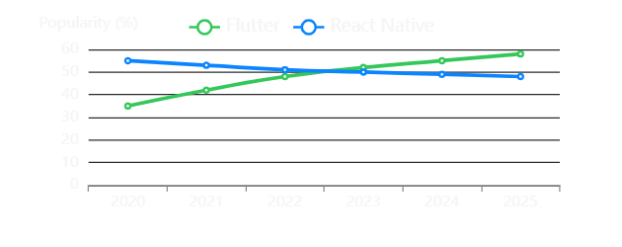
28
Framework Introduction
Flutter vs React Native: Beginner's Comparison
Feature | Flutter | React Native
Programming Language | Dart | JavaScript
Performance | ⭐⭐⭐⭐⭐ | ⭐⭐⭐⭐
Learning Curve | Moderate | Easy
Community Size | Growing fast | Very large
UI Consistency | Excellent | Good
Job Market | High demand | High demand
Which Should You Choose?
Popularity Trend
Choose Flutter if: You want best performance, beautiful UI, and don't mind learning Dart
Choose React Native if: You know JavaScript, want larger community, or have web dev background
Simple Explanation
Visual Suggestion
Both are excellent choices! It's like choosing between iPhone and Android – both work great, pick what feels right for you.
Diagram: Side-by-side feature comparison
Image: Both logos with popularity stats

Slide 30
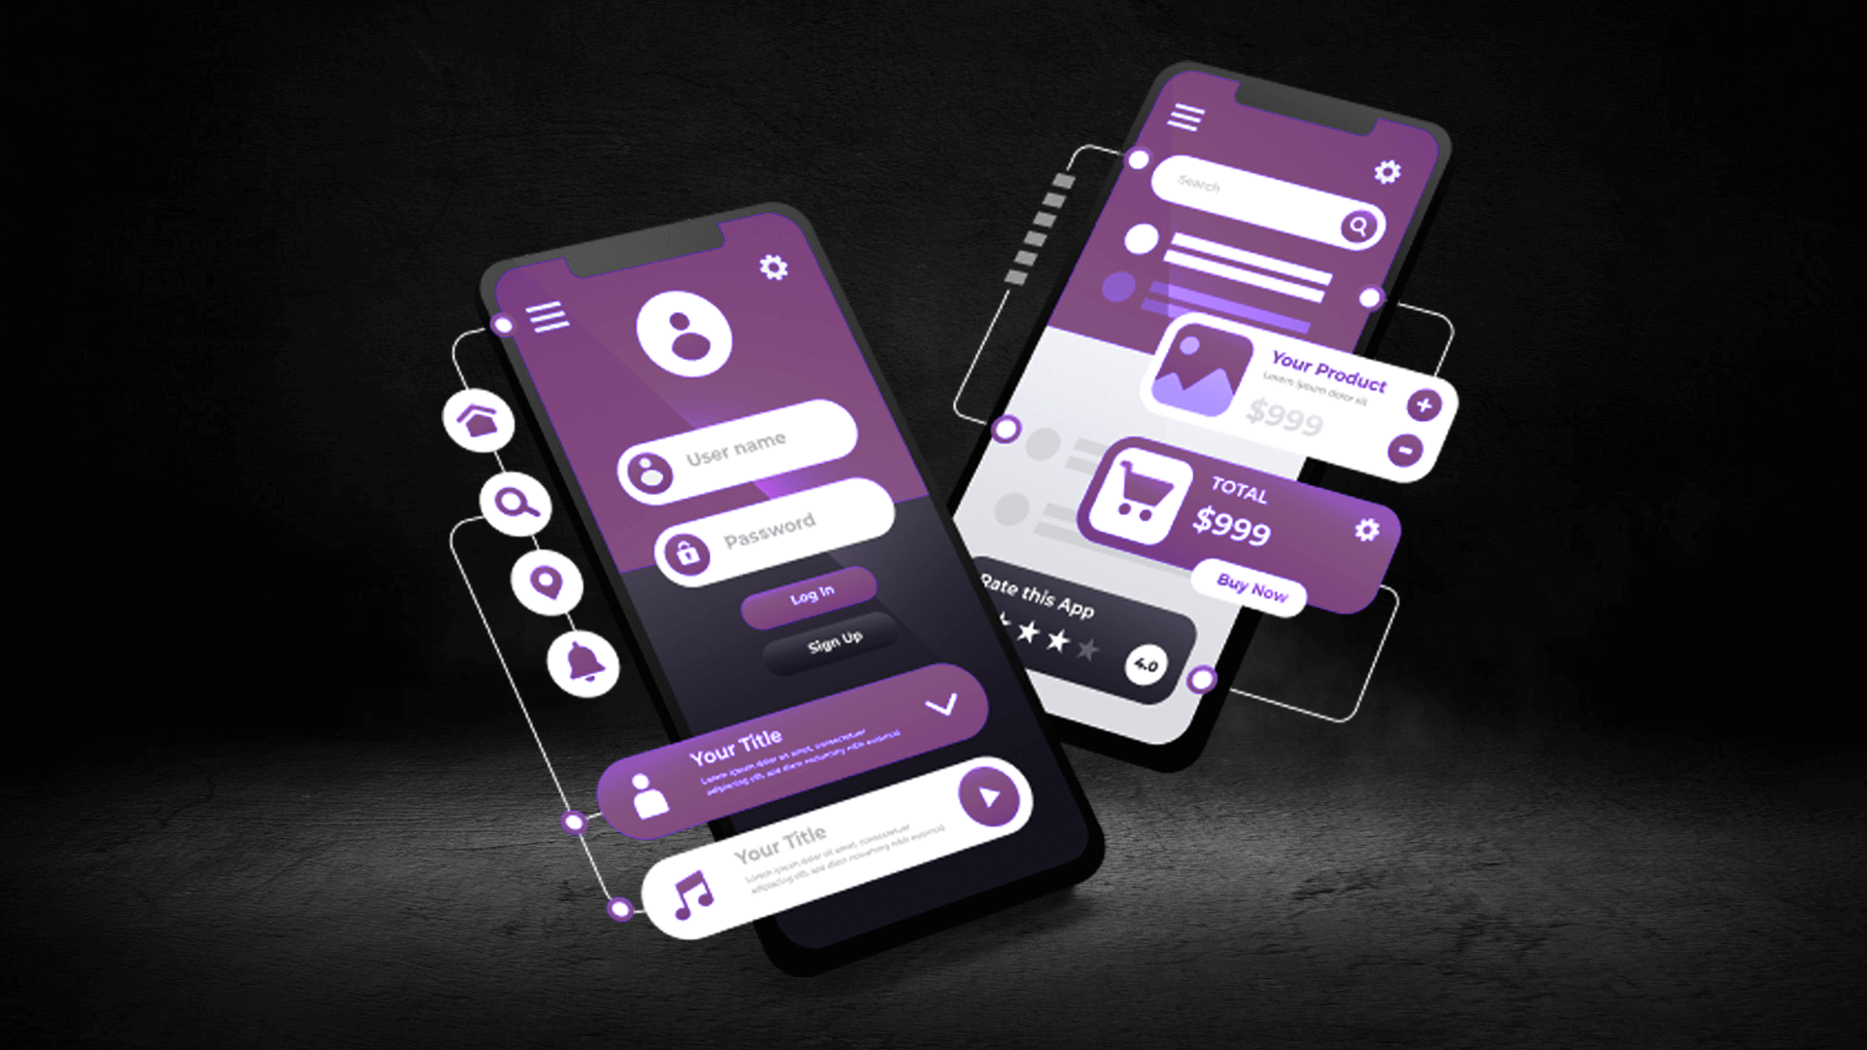
COURSE COMPLETION
Summary and Next Steps
Congratulations! You've completed Week 1 Lectures 1 & 2
What You've Learned
Your Next Steps
Mobile App Basics – What apps are, types, and how they work
1
Install Your IDE
Course Overview – Skills, objectives, and career paths
Choose Android Studio, Xcode (Mac), or VS Code and complete installation
Importance – Why mobile apps matter in daily life and business
Mobile Platforms – Android, iOS, and Cross-Platform development
2
Explore the Interface
Development Tools – Android Studio, Xcode, and VS Code setup
Click around, open menus, and get familiar with the layout
Frameworks – Introduction to Flutter and React Native
3
Start Basic Tutorials
Look for "Hello World" tutorials for your chosen framework
Remember
Every expert was once a beginner. Your journey to becoming a mobile app developer starts now!
Questions? Reach out to your instructor or classmates

